Slide 1
WEB2.0/LIBRARY2.0 WORKSHOP IRDP-DODOMA
Web2.0 on Mobile devices
Presented by
P. S. Muneja
pmuneja@udsm.ac.tz

Slide 2
Facts about Mobile phones
77% of the World population is mobile (5.3 billion subscribers)
• The smart phone sales shows the strongest growth in 2010
• Half a billion people access mobile Internet worldwide in 2009
• Over 300,000 mobile applications have been developed in
three years

Slide 3
Facts about Mobile phones…
Web 2.0 Technologies
• Web 2.0 emerged as a way to stimulate people’s participation,
contributions and collaboration in the creation of a new content over
the web.
• The implementation of the Web 2.0 tools into the library environment,
kept the librarians current and active participants in the building of a new
knowledge society generation.
Mobile Technologies
• The truth is that: your Mobile phone is not anymore just to make a phone
call or send a SMS messages.
• As the smart phone users continues to grow, so the patrons using these
phones to access information through mobile applications will grow.
• To remain relevant and to become participants, the librarians need to
adapt the provision of services and access to resources

Slide 7
Mobile social Networks
Mobile social networking is social networking where one or more individuals of similar interests or commonalities, conversing and connecting with one another using the mobile phone. Much like web based social networking, mobile social networking occurs in virtual communities.
http://en.wikipedia.org/wiki/Mobile_social_network

Slide 8
Social networking sites for your mobile
Mobile social networks and communities continue to grow at a staggering rate. According to mobile research firm M:Metrics, 12.3 million consumers in the US and Western Europe used mobile phones to access social networking sites in June 2007. Mobile social networking looks like it’s here to stay so we’ve compiled a list of 30 + social network sites you can access from your mobile phone. Now there’s no excuse for ignoring your friends.
http://socialmediatrader.com/38-social-networking-sites-for-your-mobile/

Slide 12
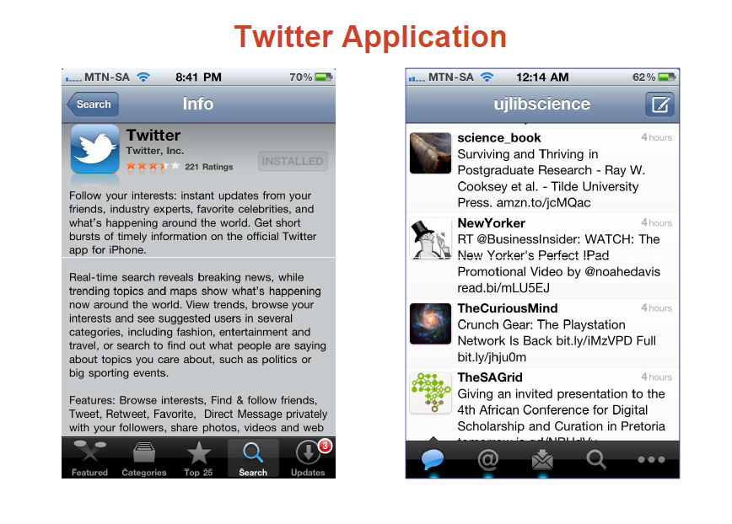

Slide 13
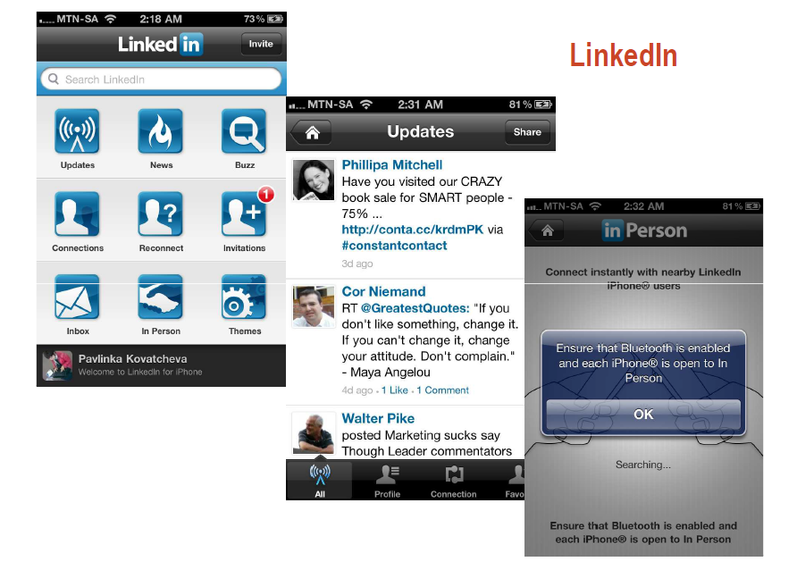

Slide 24
References
http://technology.timesonline.co.uk/tol/news/tech_and_web/article3897340.ece

